Slide 1

Unit-02 User Research
UI/UX Designing (UI/UX)
DU # 2301CS622
Prof. Mayur Padia
Department of Computer Science & Engineering
mayur.padia@darshan.ac.in
99255 15118

Slide 2

Looping
Outline
Methods of UX research - Qualitative/Quantitative
Data Gathering Methods and Sources
Expert Review
Interviews
Surveys and Email Questionnaire
Observation - Eye Tracking
Clickstream Analysis
Focus Group
User Groups
Competitor Analysis

Slide 3
Facts
In a study of 630 U.S. and UK executives by the consulting firm Accenture, 57% of the executives reported that “inability to meet customer needs” had resulted in failures of new products or services.
Fifty percent further blamed the “lack of a new or unique customer-perceived value proposition”.
Some more facts

Slide 4
Methods of UX research
Section - 1

Slide 5
Understanding the role of research in design
UX research focuses on understanding user behaviors, needs, and motivations through observation and feedback.
The goal of user experience research is to prioritize the user.
UX research can help bridge the gap between what a business thinks the user needs and what the user actually needs.
User research is a continuous part of the product development life cycle and takes place before, during, and after Design phase.
There are two key parts to every UX design project:
conducting research to learn about the users you’re designing for, and
gathering feedback about their perspectives (views).
UX design is all about putting the user first, and research helps designers understand those users.
UX research aligns what you, as the designer, think the user needs with what the user actually needs.

Slide 6
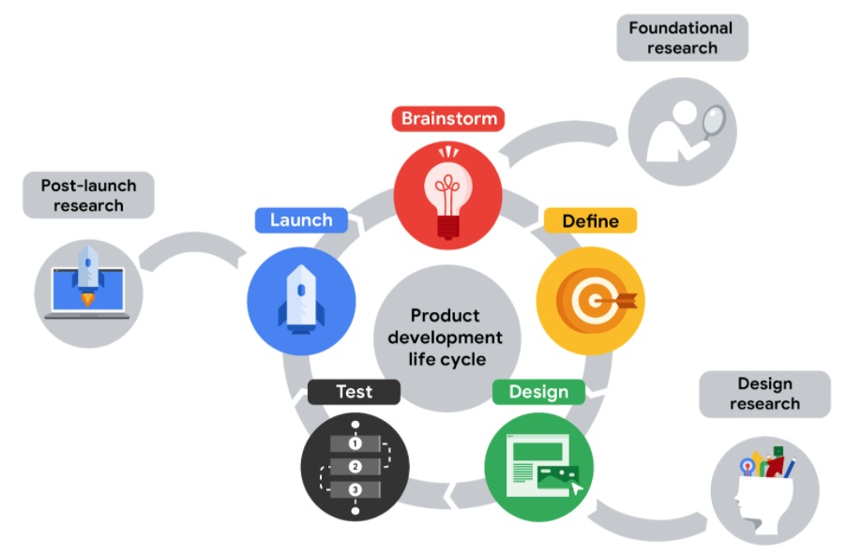
Understanding the role of research in design (contd.)

Slide 7
Types of User Research
Foundational Research
It is also called strategic or generative research.
It takes place before anything is designed.
Question we need to ask during fundamental research are:
What should we build?
What are the user problems?
How can we solve them?
Here, the goal is to help define the problem you would like to design a solution for.
Here, research includes talking with users and identifying their pain points when using a product.

Slide 8
Types of User Research (contd.)
Design Research
It is also called tactical research.
Here, research takes place during the design phase.
Question we need to ask
How should we build it?
How was your experience using the prototype today?
How easy or difficult was it to use? Why?
Did you encounter any challenges?
Here, the goal is to inform how the product should be built.
The most common method used to conduct design research is a usability study, which is a technique to evaluate a product by testing it on users.
It gives designers a chance to reduce the problems that occur as users interact with your prototype.

Slide 9
Types of User Research -> Design Research (contd.)
You can conduct design research very early in the design process when you have paper sketches, or you can wait until you have a prototype to test with users.
Each time you create a new version of your design, new research should be done to evaluate what works well and what needs to be changed.

Slide 10
Types of User Research (contd.)
Post-launch Research
It can occur after launch.
Post-launch research can be used to evaluate how well a launch feature is meeting the needs of users.
Question we need to ask
Did we succeed?
Here, the goal is to understand how users experienced the product and whether it was a good or poor user experience.
You might also want to check your product's performance against the competition.

Slide 11
UX Researcher Qualities
Empathy: able to understand someone else’s feeling or thoughts in a situation
Pragmatism: focused on reaching goals
Collaboration: can work with a range of people, personalities, and work styles

Slide 12
Research Methods
Based on who conducts the research
Primary research is the one you conduct yourself by interviewing the user, or through usability study
Secondary research uses information someone else has put together, i.e. from book, article or journals
Based on types of data collected
Data can be collected through qualitative or quantitative research
Quantitative research focuses on data that can be gathered by counting or measuring
It is often based on surveys of large group of people using numerical answers
It answers questions like;
How many?
How much?
If you want to know how majority of the users are feeling for your product than use quantitative research method.
Qualitative research focuses on why and how things happen
It is based on interviews with smaller number of people and understand their needs in greater details
It answers questions like; why or how did this happen?
If you want to know why user has bad experience with your product and want to improve use it.

Slide 13
Data Gathering Methods and Sources
Section - 2

Slide 14
Common Research Methods
Design review: A usability-inspection method in which (usually) one reviewer examines a design to identify usability problems.
Common types of design reviews include:
Heuristic evaluation: a type of design review in which the design is evaluated for compliance with a set of heuristics such as Jakob Nielsen’s 10 Usability Heuristics.
Standalone design critique: a design review in which an in-progress design is analyzed (usually as a group conversation) to determine whether it meets its objectives and provides a good experience.
Expert review: a design review in which a UX expert inspects a system (such as a website or application, or a section therein) to check for possible usability issues.
Expert reviews involve the analysis of a design by a UX expert with the goal of identifying usability problems and strengths.

Slide 15
Common Research Methods
Interviews
A research method used to collect in-depth information on people's opinions, thoughts, experiences, and feelings.
You’ll often conduct interviews of your target users themselves.
Ask open ended questions like;
How would you rate your experience using the app on a scale of 1-10?
How was your experience using the app?
A qualitative research method includes open-ended questions that require participants to explain their answers by providing more details.
A quantitative research method includes only close-ended questions, like questions that require only “yes” or “no” responses or set multiple choice questions.
Use when your questions require a detailed response.

Slide 16
Common Research Methods (contd.)
Surveys
Surveys are an activity where many people are asked the same questions in order to understand what most people think about a product.
Usually conducted with large number of users
Includes a mix of quantitative and qualitative questions.
Open-ended questions for qualitative research, which allow research participants to clarify their survey responses, as well as close-ended questions for quantitative research, which generate numerical data.
Most useful after you have some initial understanding of the users' pain points and want to solidify that by surveying a larger number of people.

Slide 17
Common Research Methods (contd.)
Usability Study
Usability studies are a technique that help us evaluate a product by testing it on users.
It is usually conducted in-person.
You can identify pain points that the user experiences with different prototypes, so the issues can be fixed before the final product launches.
It focuses on qualitative research during usability studies can generate more personal insights by assessing the behavior of users as they experience the product.
Quantitative research can also be used when conducting usability studies to understand participants’ impressions of the product.
Use when: The usability study data is then used to improve the UX of the design.
A post-launch usability study might include data like success metrics and key performance indicators (KPIs)

Slide 18
The KPIs for an app or new product launch might include things like how much time the user spent on a task or the number of clicks they used to make a purchase.

Slide 19
Email Questionnaire
An email questionnaire is a research method where a set of structured questions is sent to participants via email to gather insights on user experience, behaviors, and preferences.
Key Features
Delivered via email to a targeted audience.
Contains open-ended, or closed-ended questions.
Participants respond at their convenience.
Purpose in UX Research
Collect feedback on product usability, design, and functionality.
Understand user needs and expectations.
Identify pain points and areas for improvement.

Slide 20
Email Questionnaire (contd.)
Advantages
Cost-effective: Minimal resources required.
Convenient: Participants can respond at their own pace.
Wide Reach: Easily scalable to diverse user bases.
Best practices
Personalization: Address recipients by name to increase engagement.
Clarity: Keep questions concise and straightforward.
Structure: Start with general questions, then move to specifics.
Mobile-Friendly Design: Ensure accessibility across devices.
Follow-Up: Send reminders to improve response rates.

Slide 21
Email Questionnaire (contd.)
General Experience Questions |  | Usability & Navigation
How would you describe your overall experience with our product/service? | On a scale of 1-10, how satisfied are you with the product’s ease of use? | Were you able to find what you were looking for easily? | If not, what was challenging? What features do you use most frequently, and why?
- | - | How intuitive is the navigation/menu structure of our product? | -
Feedback on Design |  | User Needs & Improvements
How would you rate the visual design of the product? | Is there anything about the design that you find distracting or unappealing? | What additional features or functionalities would you like to see? | What, if anything, would you change to improve your experience?
Wrap-Up
Would you recommend this product to others? Why or why not? | - | - | -

Slide 22
Usability Heuristics
Section - 3

Slide 23
10 Usability Heuristics for User Interface Design
Visibility of System Status
Match Between the System and the Real World
User Control and Freedom
Consistency and Standards
Error Prevention
Recognition Rather than Recall
Flexibility and Efficiency of Use
Aesthetic and Minimalist Design
Help Users Recognize, Diagnose, and Recover from Errors
Help and Documentation

Slide 24
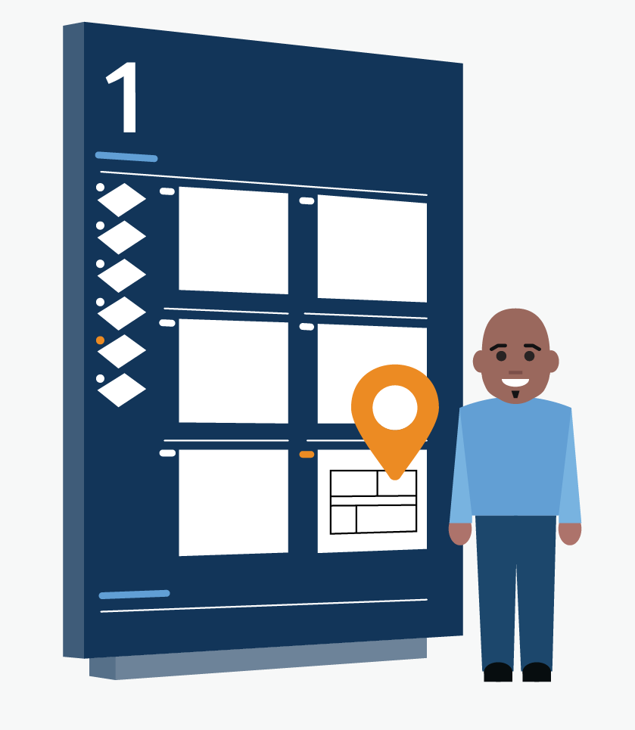
Visibility of System Status
The design should always keep users informed about what is going on, through appropriate feedback within a reasonable amount of time.
When users know the current system status, they learn the outcome of their prior interactions and determine next steps.
Predictable interactions create trust in the product as well as the brand.
Tips
Communicate clearly to users what the system’s state is — no action with consequences to users should be taken without informing them.
Present feedback to the user as quickly as possible
(ideally, immediately).
Build trust through open and continuous communication.

Slide 25
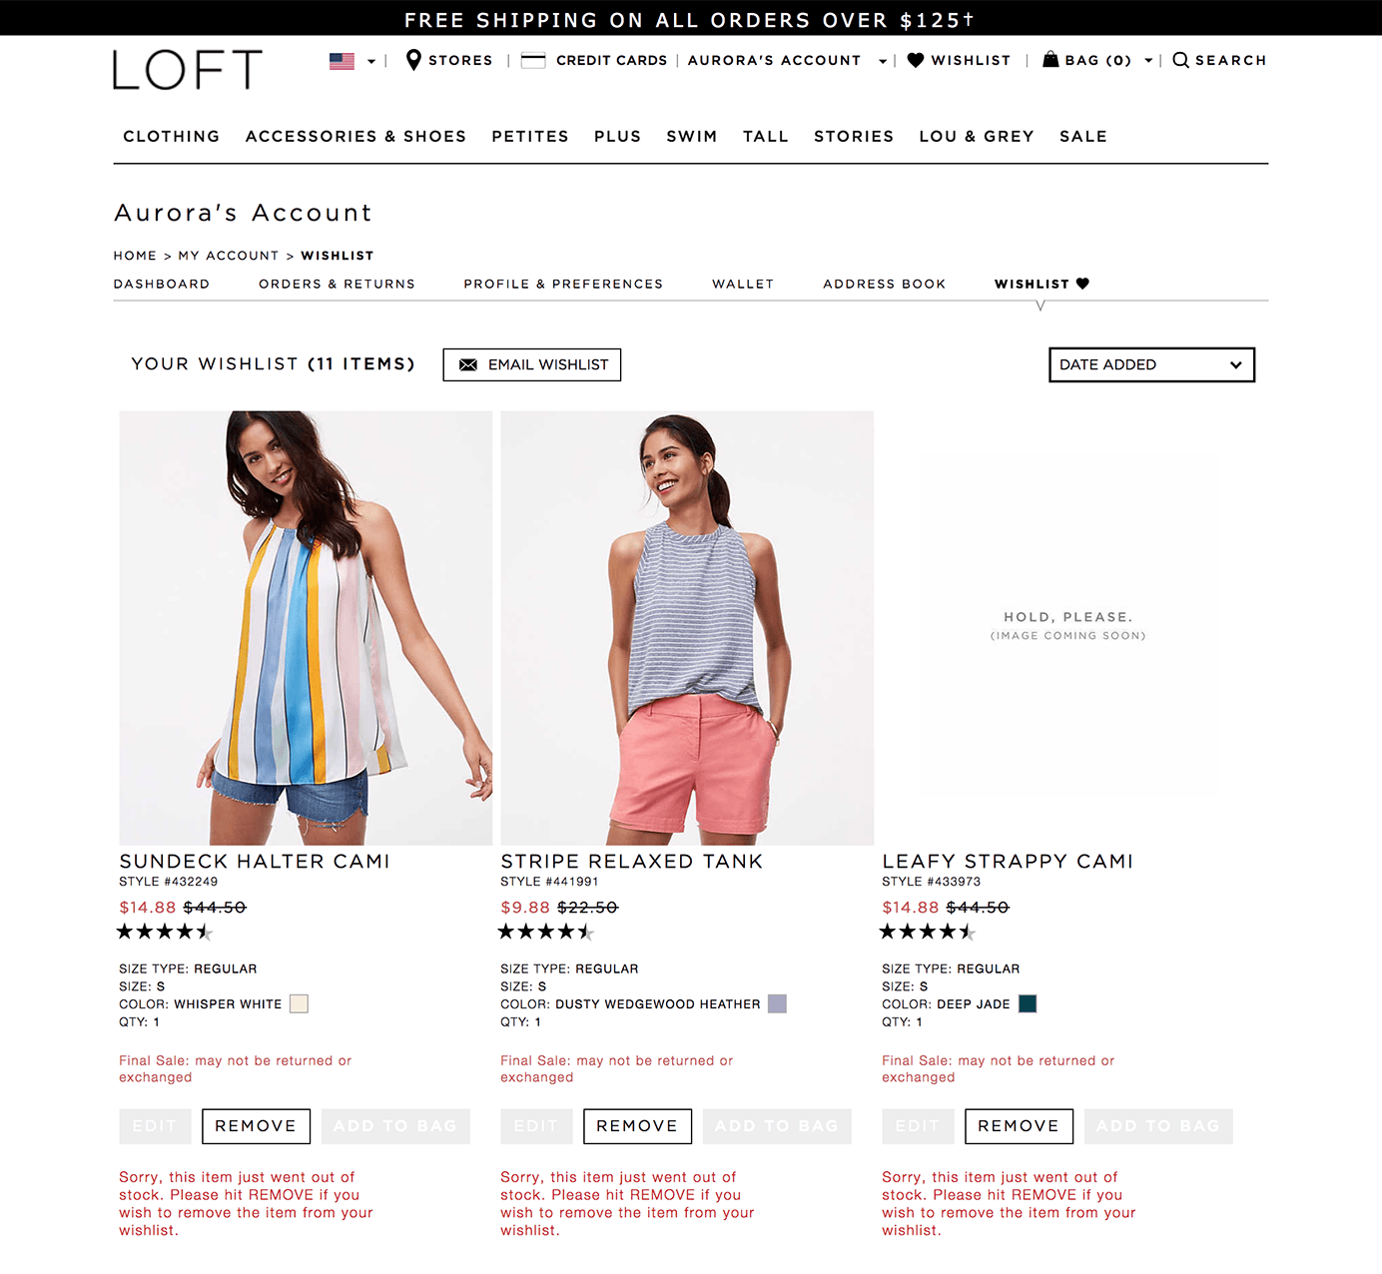
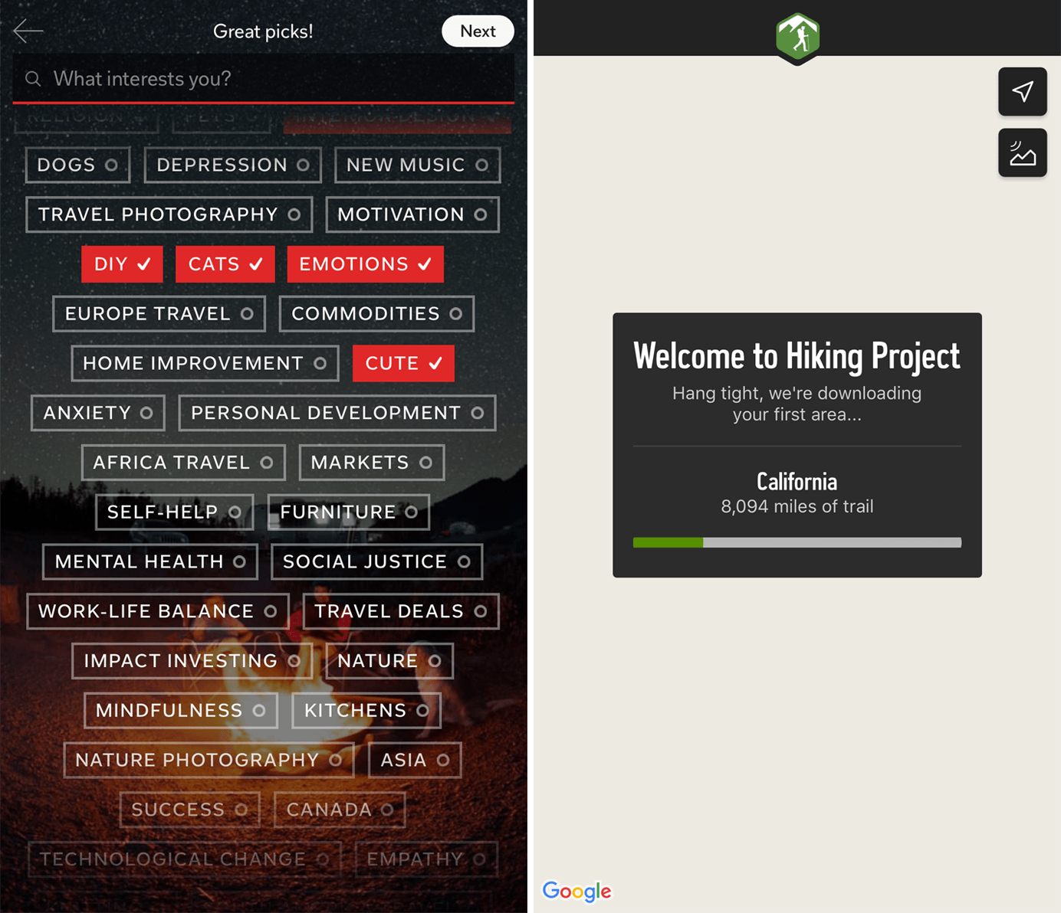

Do
Do

Slide 26
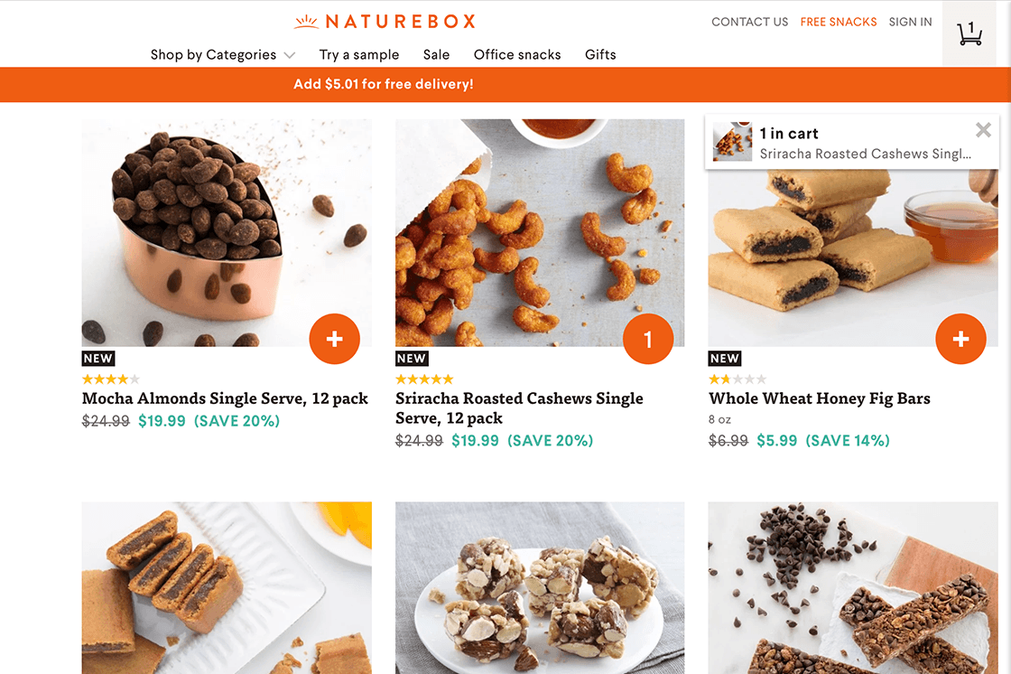
Do

Slide 27
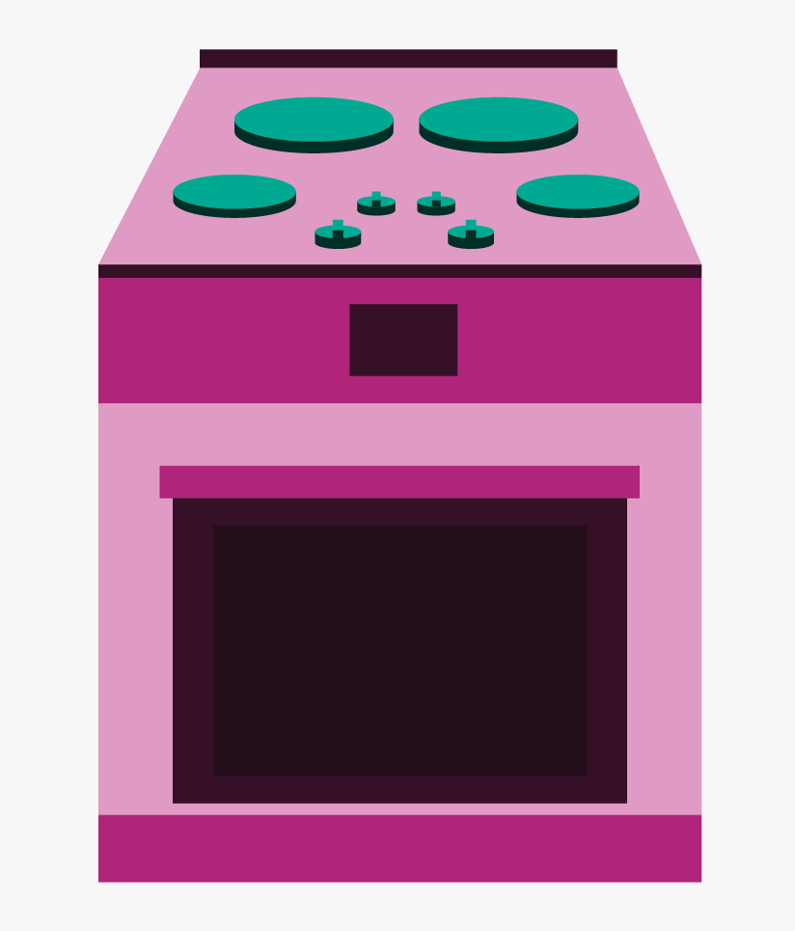
Match Between the System and the Real World
The design should speak the users' language.
Use words, phrases, and concepts familiar to the user, rather than internal jargon.
Follow real-world conventions, making information appear in a natural and logical order.
Terms, concepts, icons, and images that seem perfectly clear to you and your colleagues may be unfamiliar or confusing to your users.
Tips
Ensure that users can understand meaning without having
to go look up a word’s definition.
Never assume your understanding of words or concepts
will match that of your users.
User research will uncover your users' familiar terminology,
as well as their mental models around important concepts.

Slide 28
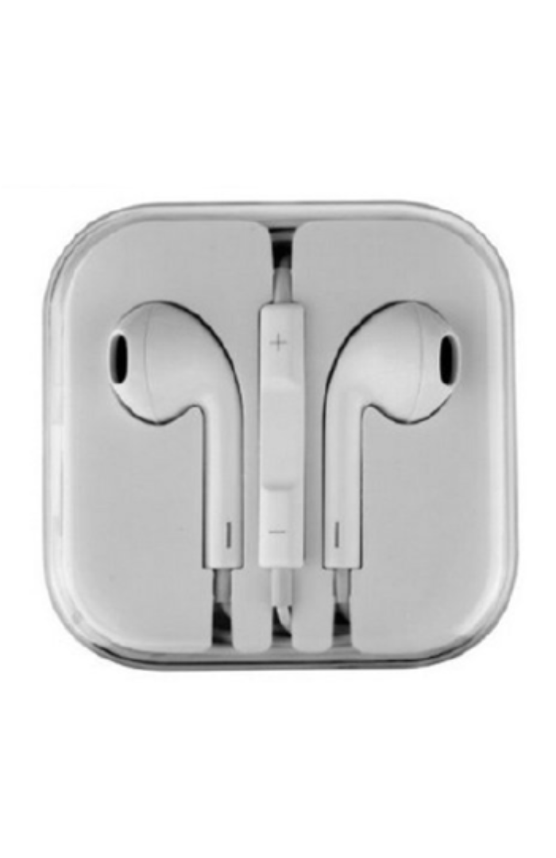
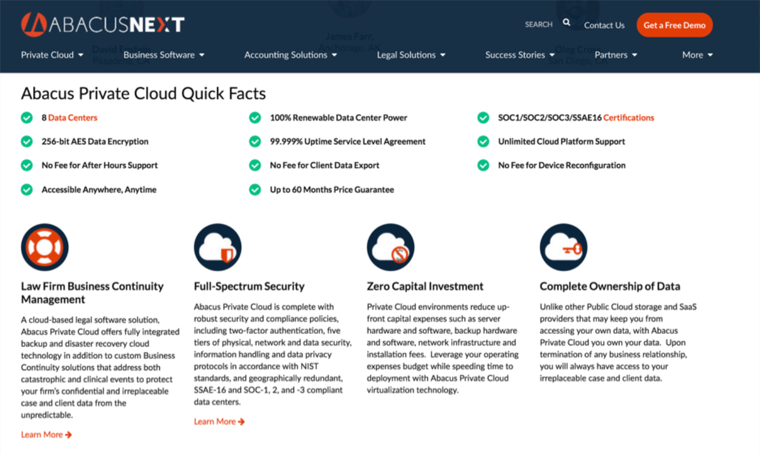

Do
Don’t

Slide 29
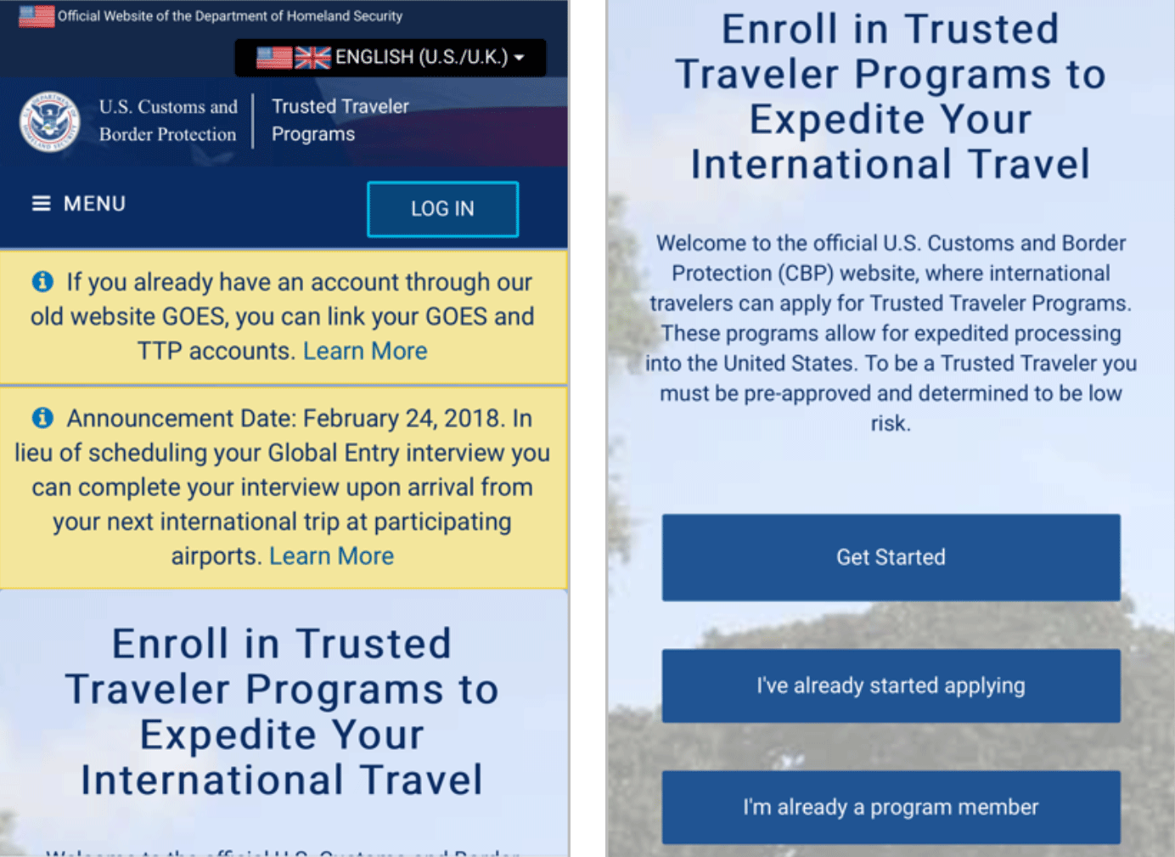
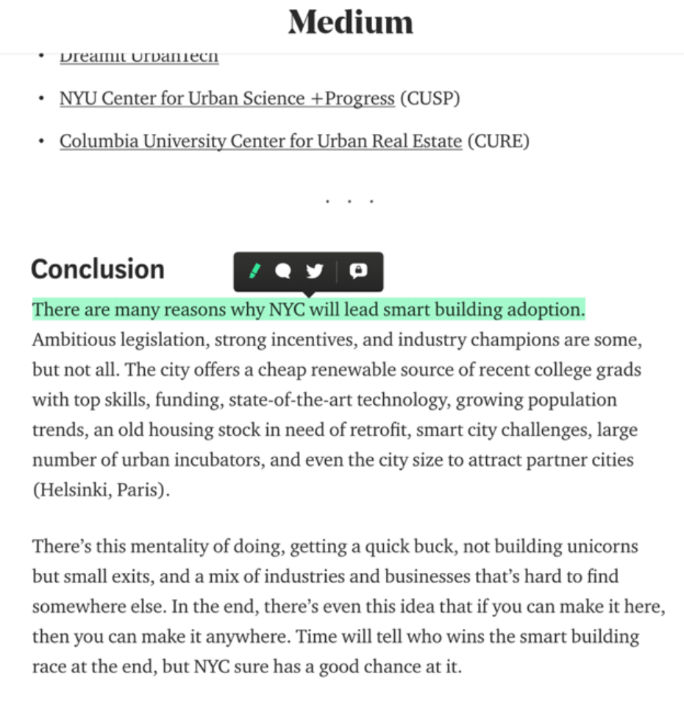
Do
Don’t

Slide 30
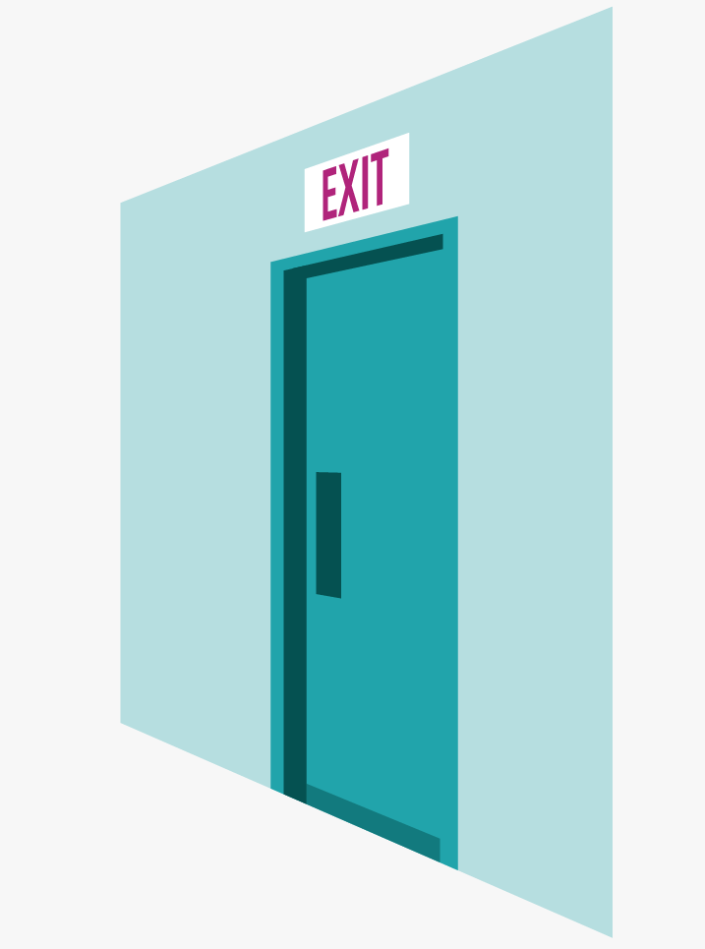
User Control and Freedom
Users often perform actions by mistake. They need a clearly marked "emergency exit" to leave the unwanted action without having to go through an extended process.
When it's easy for people to back out of a process or undo an action, it fosters a sense of freedom and confidence.
Exits allow users to remain in control of the system and avoid getting stuck and feeling frustrated.
Tips
Support Undo and Redo.
Show a clear way to exit the current interaction, like a Cancel button.
Make sure the exit is clearly labeled and discoverable.

Slide 31
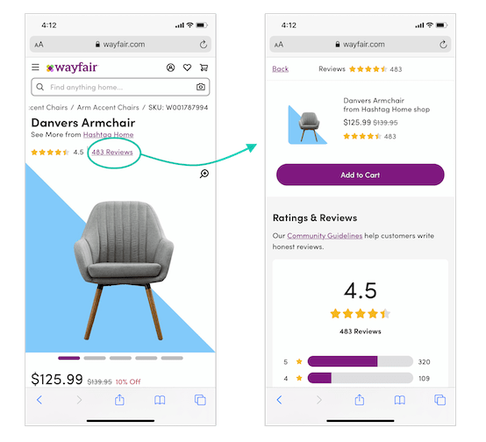
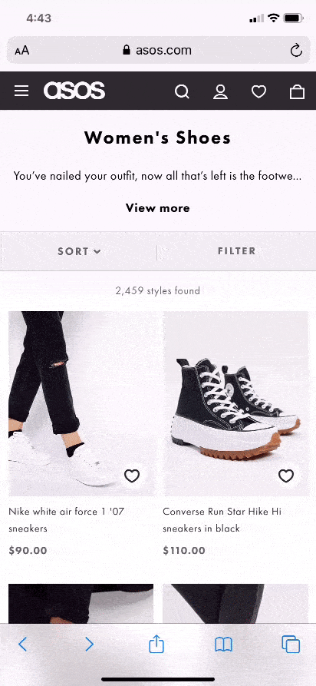
Do
Don’t

Slide 32
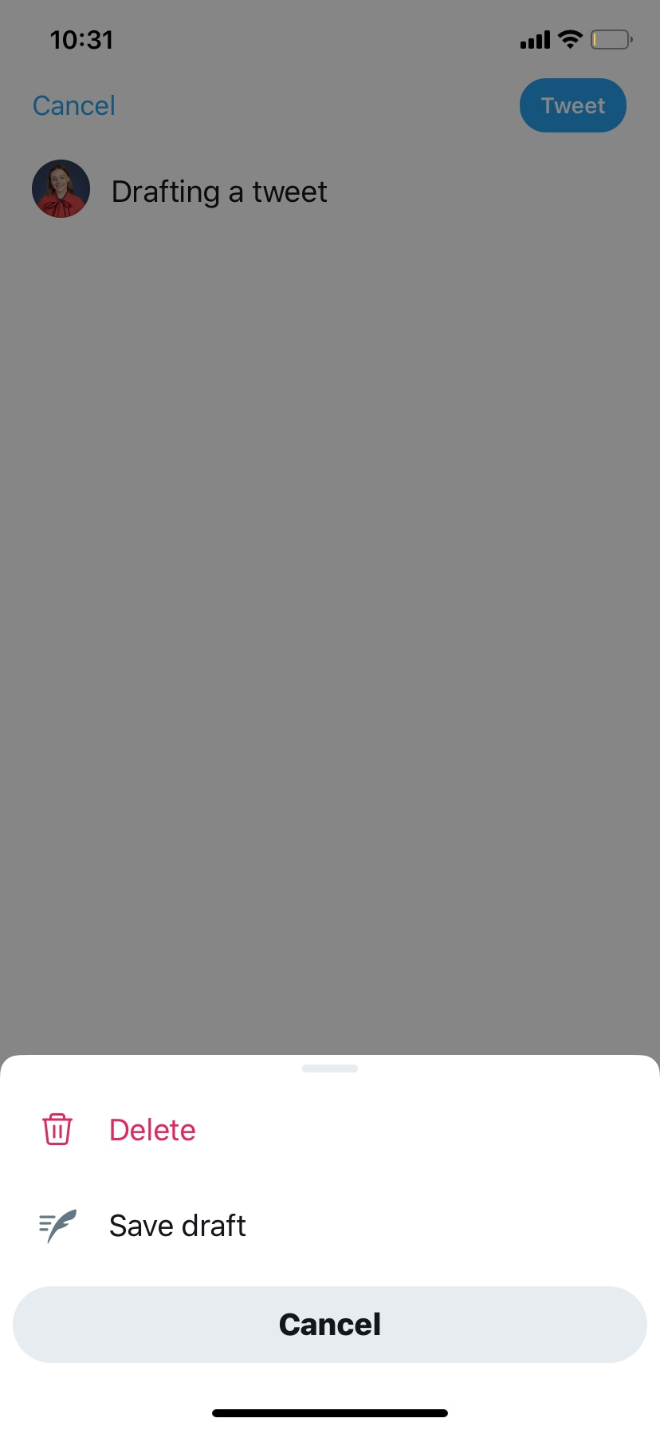
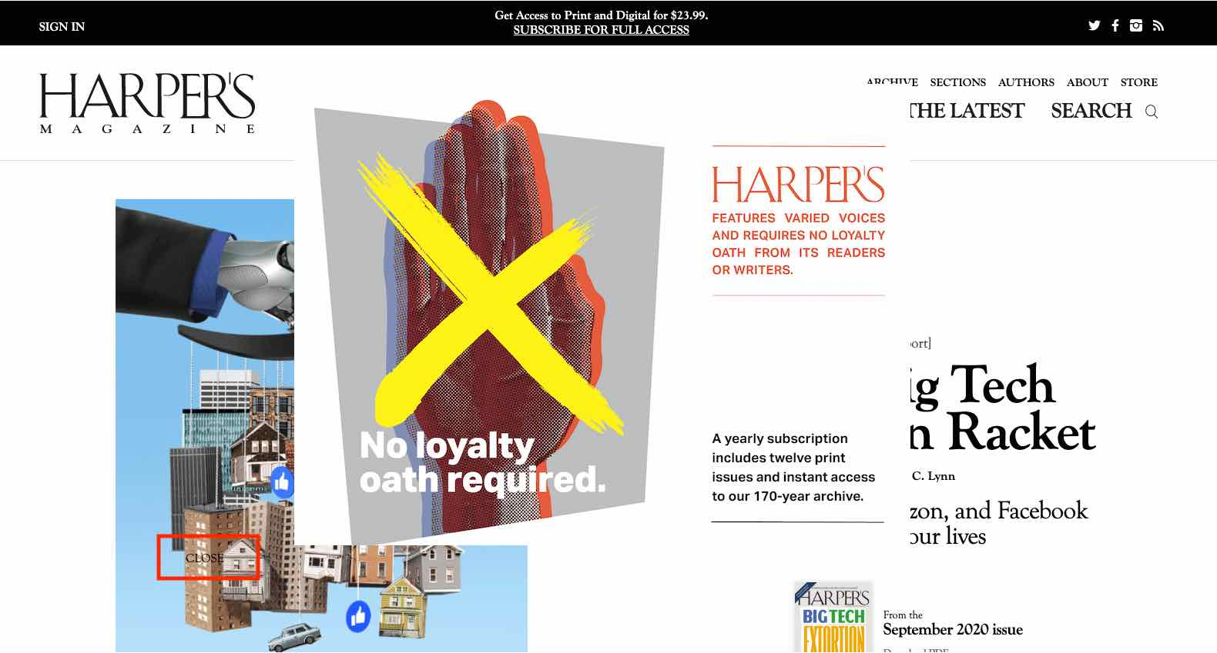
Do
Don’t

Slide 33
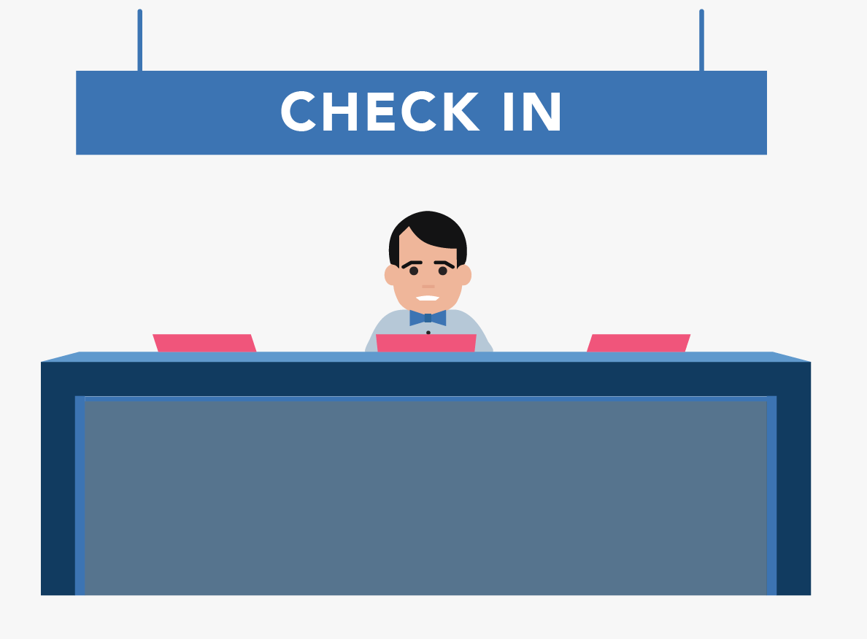
Consistency and Standards
Users should not have to wonder whether different words, situations, or actions mean the same thing. Follow platform and industry conventions.
Jakob's Law states that people spend most of their time using digital products other than yours. Users’ experiences with those other products set their expectations. Failing to maintain consistency may increase the users' cognitive load by forcing them to learn something new.
Tips
Improve learnability by maintaining both types of consistency:
internal and external.
Maintain consistency within a single product or a family
of products (internal consistency).
Follow established industry conventions

Slide 34
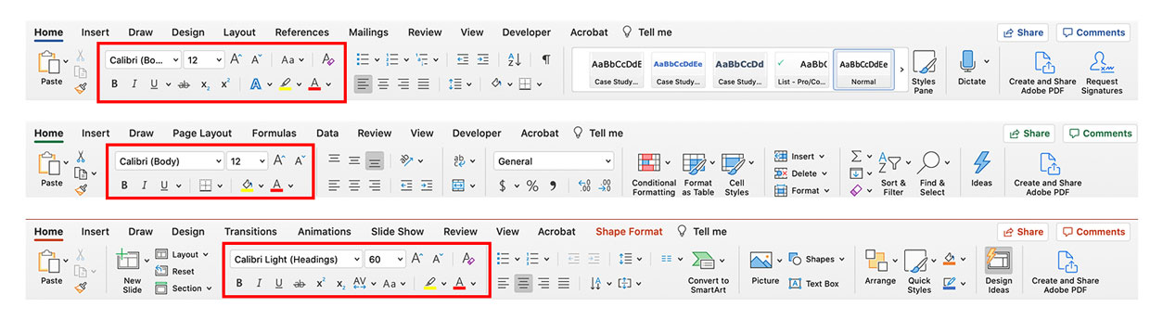
Do

Slide 35
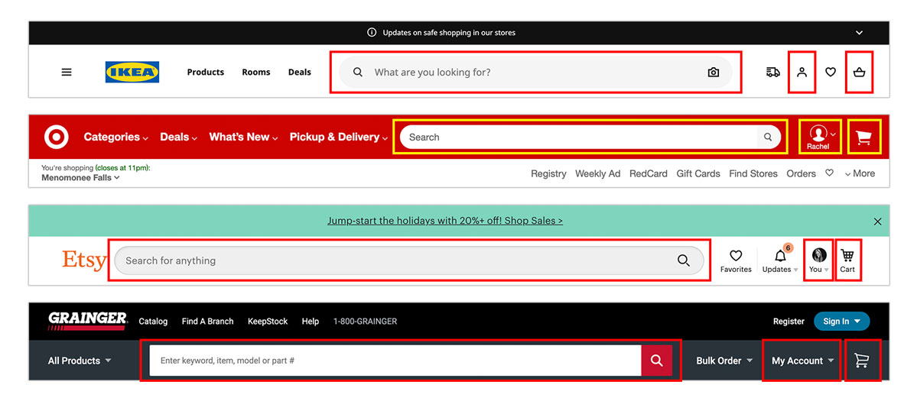
Do

Slide 36
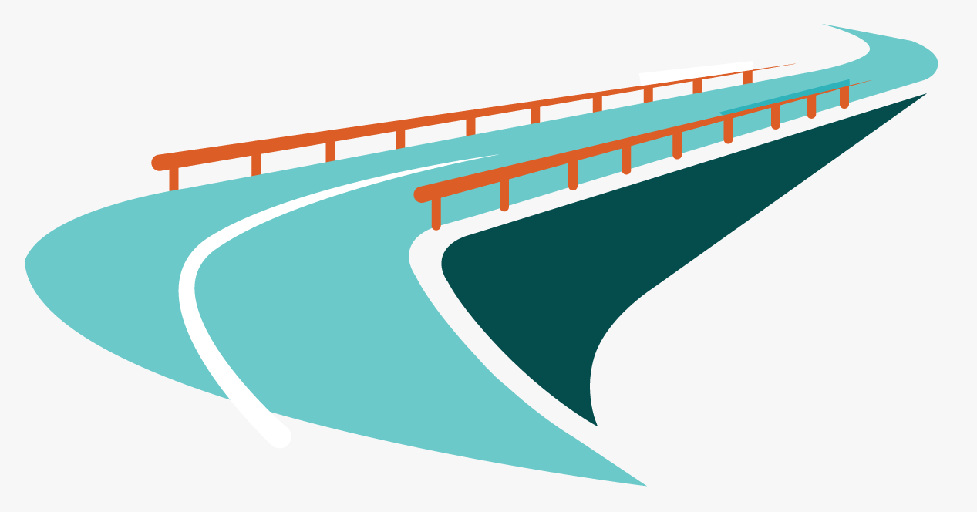
Error Prevention
Good error messages are important, but the best designs carefully prevent problems from occurring in the first place.
Either eliminate error-prone conditions, or check for them and present users with a confirmation option before they commit to the action.
There are two types of errors: slips and mistakes.
Slips are unconscious errors caused by inattention.
Mistakes are conscious errors based on a mismatch between the user’s mental model and the design.
Tips
Prioritize your effort: Prevent high-cost errors first,
then little frustrations.
Avoid slips by providing helpful constraints
and good defaults.
Prevent mistakes by removing memory burdens,
supporting undo, and warning your users.

Slide 37
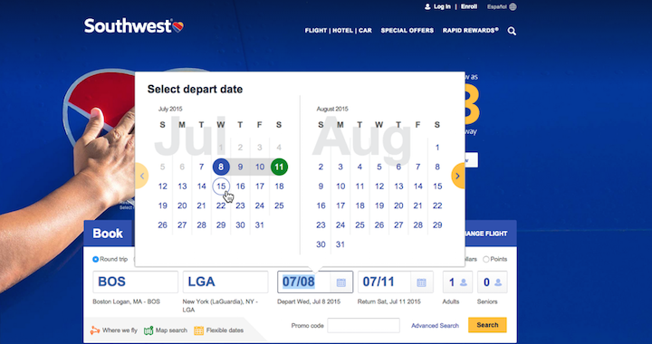
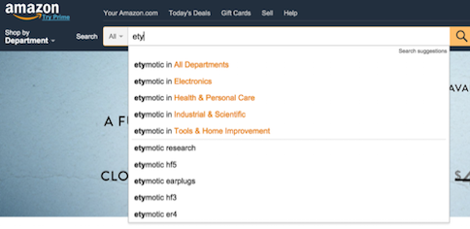
Do
Do

Slide 38
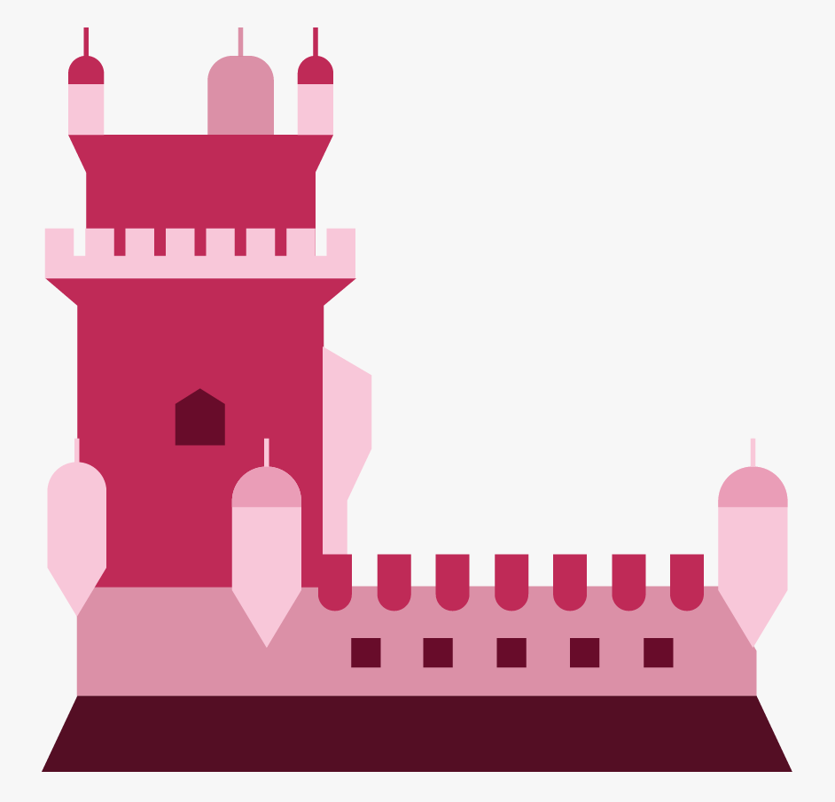
Recognition Rather than Recall
Minimize the user's memory load by making elements, actions, and options visible.
The user should not have to remember information from one part of the interface to another.
Information required to use the design (e.g. field labels or menu items) should be visible or easily retrievable when needed.
Interfaces that promote recognition reduce the amount of cognitive effort required from users.
Tips
Let people recognize information in the interface,
rather than forcing them to remember (“recall”) it.
Offer help in context, instead of giving users a long
tutorial to memorize.
Reduce the information that users have to remember.
People are more likely to answer the question
Is Lisbon the capital of Portugal? Rather than What’s the capital of Portugal?

Slide 39
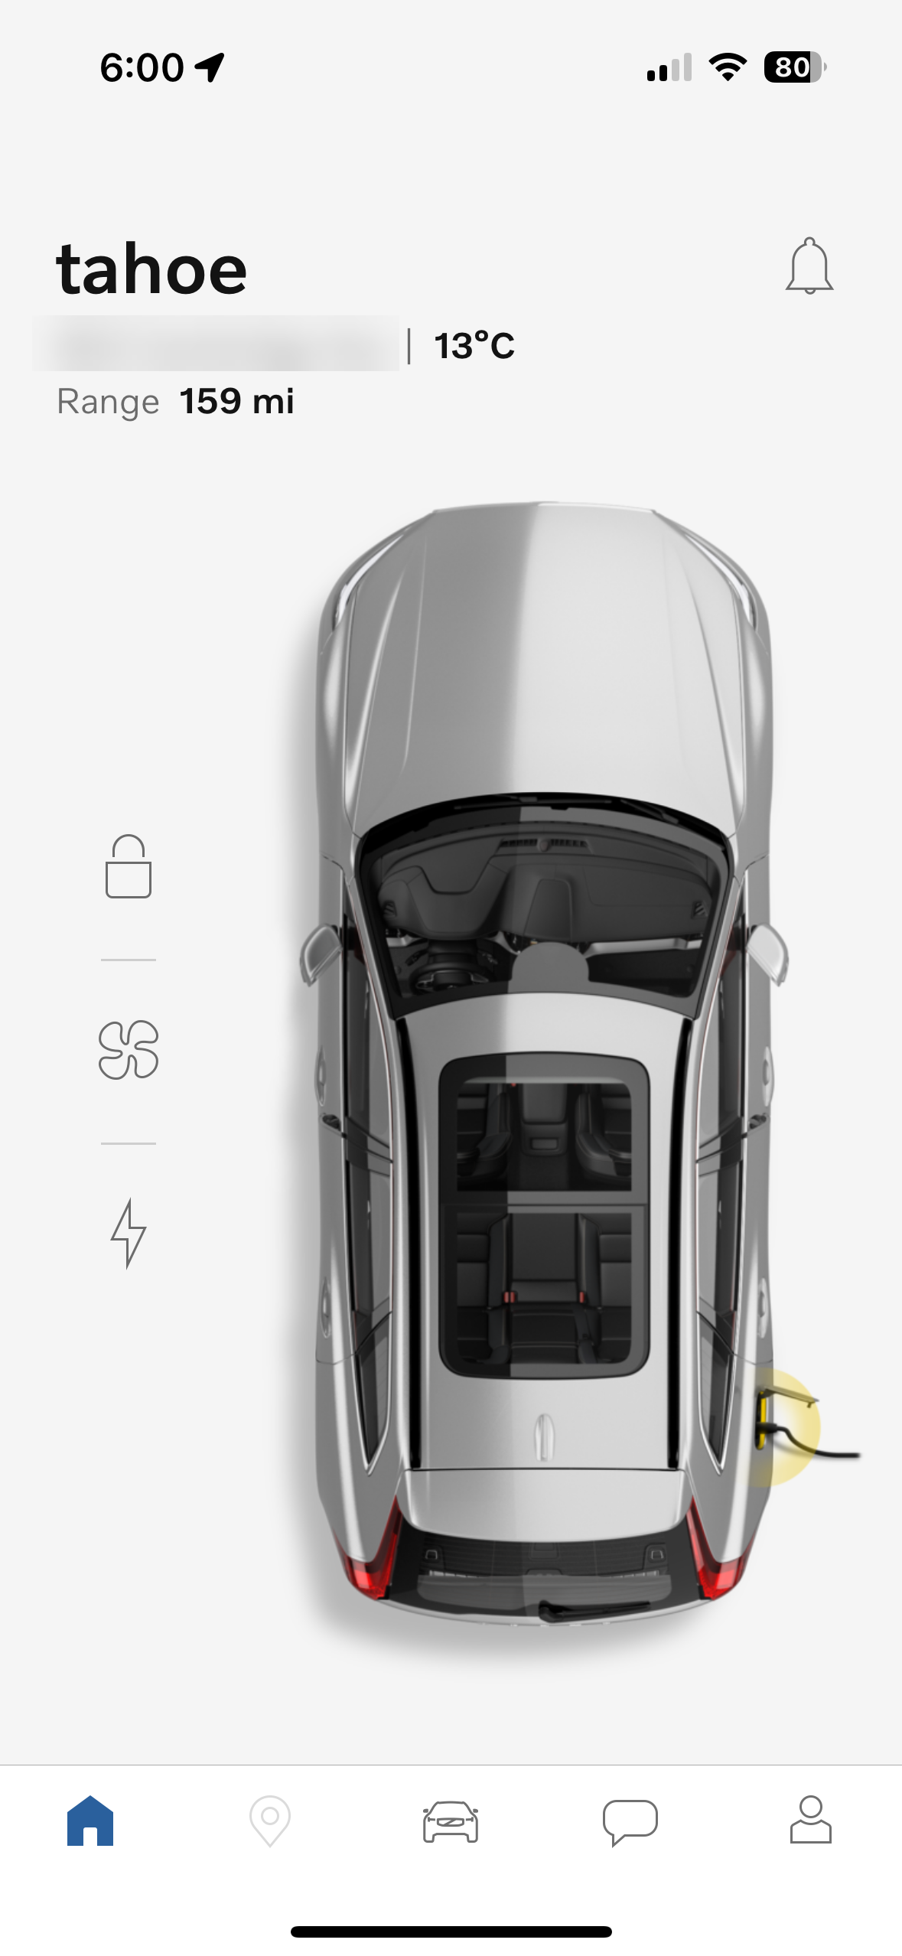
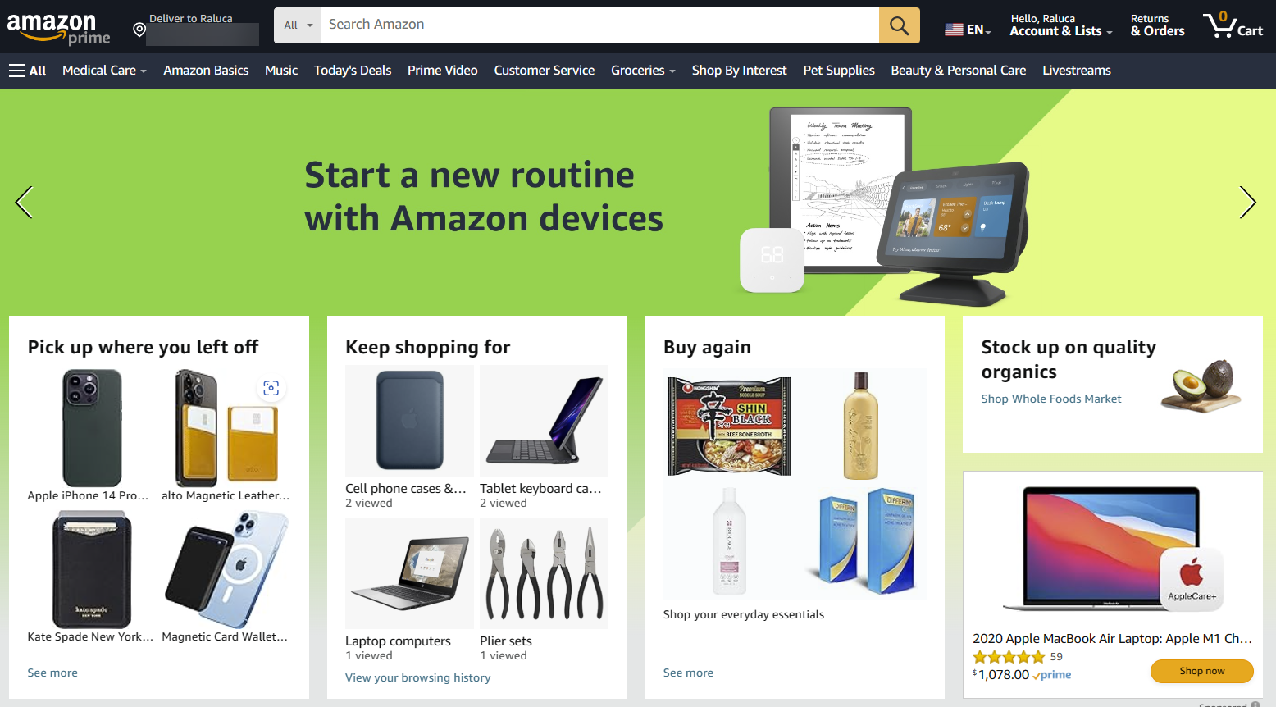
Don’t
Do

Slide 40
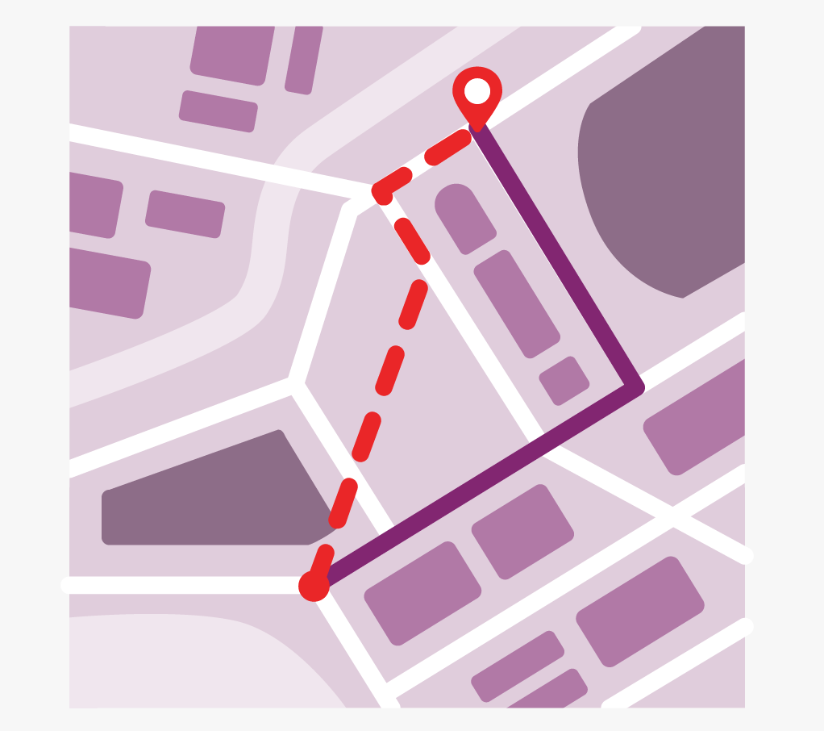
Flexibility and Efficiency of Use
Shortcuts — hidden from novice users — may speed up the interaction for the expert user so that the design can cater to both inexperienced and experienced users.
Allow users to tailor frequent actions.
Flexible processes can be carried out in different ways, so that people can pick whichever method works for them.
Tips
Provide accelerators like keyboard shortcuts
and touch gestures.
Provide personalization by tailoring content
and functionality for individual users.
Allow for customization, so users can make
selections about how they want the product to work.

Slide 41
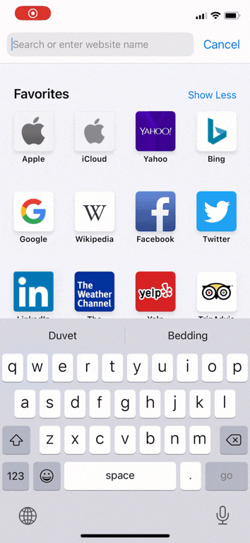
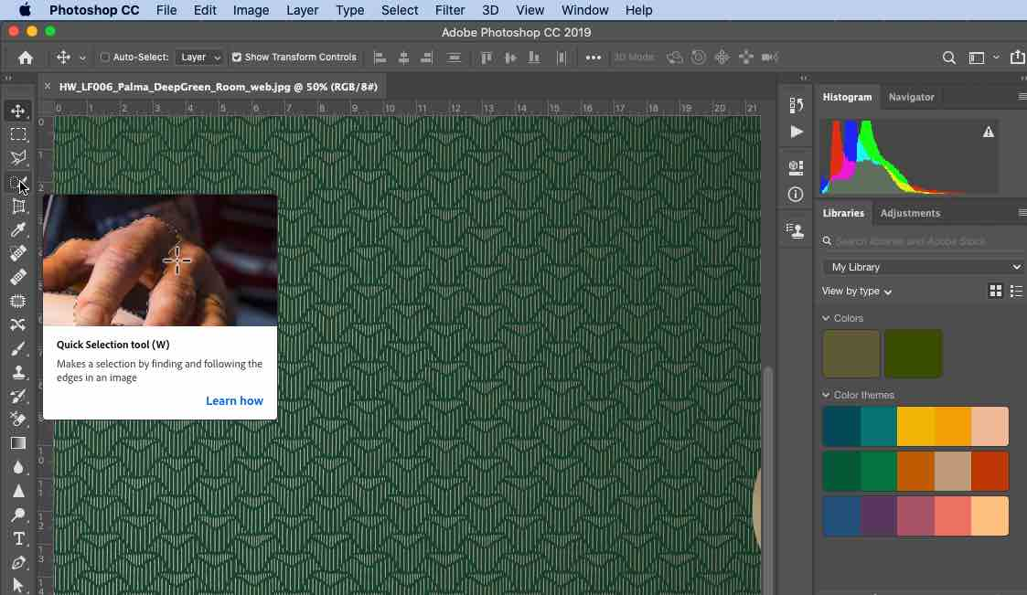
Do
Do

Slide 42
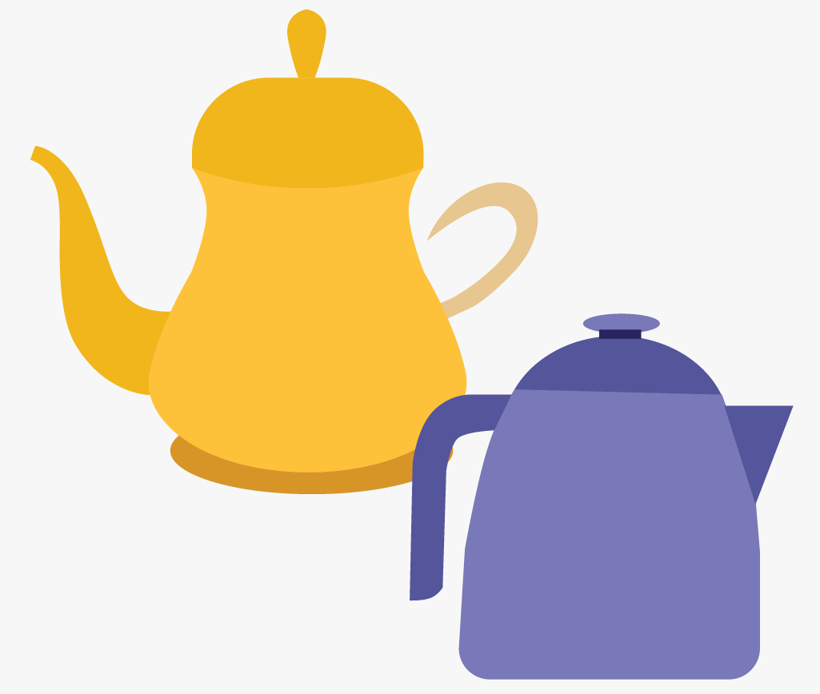
Aesthetic and Minimalist Design
Interfaces should not contain information that is irrelevant or rarely needed.
Every extra unit of information in an interface competes with the relevant units of information and diminishes their relative visibility.
This heuristic doesn't mean you have to use a flat design — it's about making sure you're keeping the content and visual design focused on the essentials.
Ensure that the visual elements of the interface support the user's primary goals
Tips
Keep the content and visual design of UI
focused on the essentials.
Don't let unnecessary elements distract users
from the information they really need.
Prioritize the content and features to support
primary goals.

Slide 43
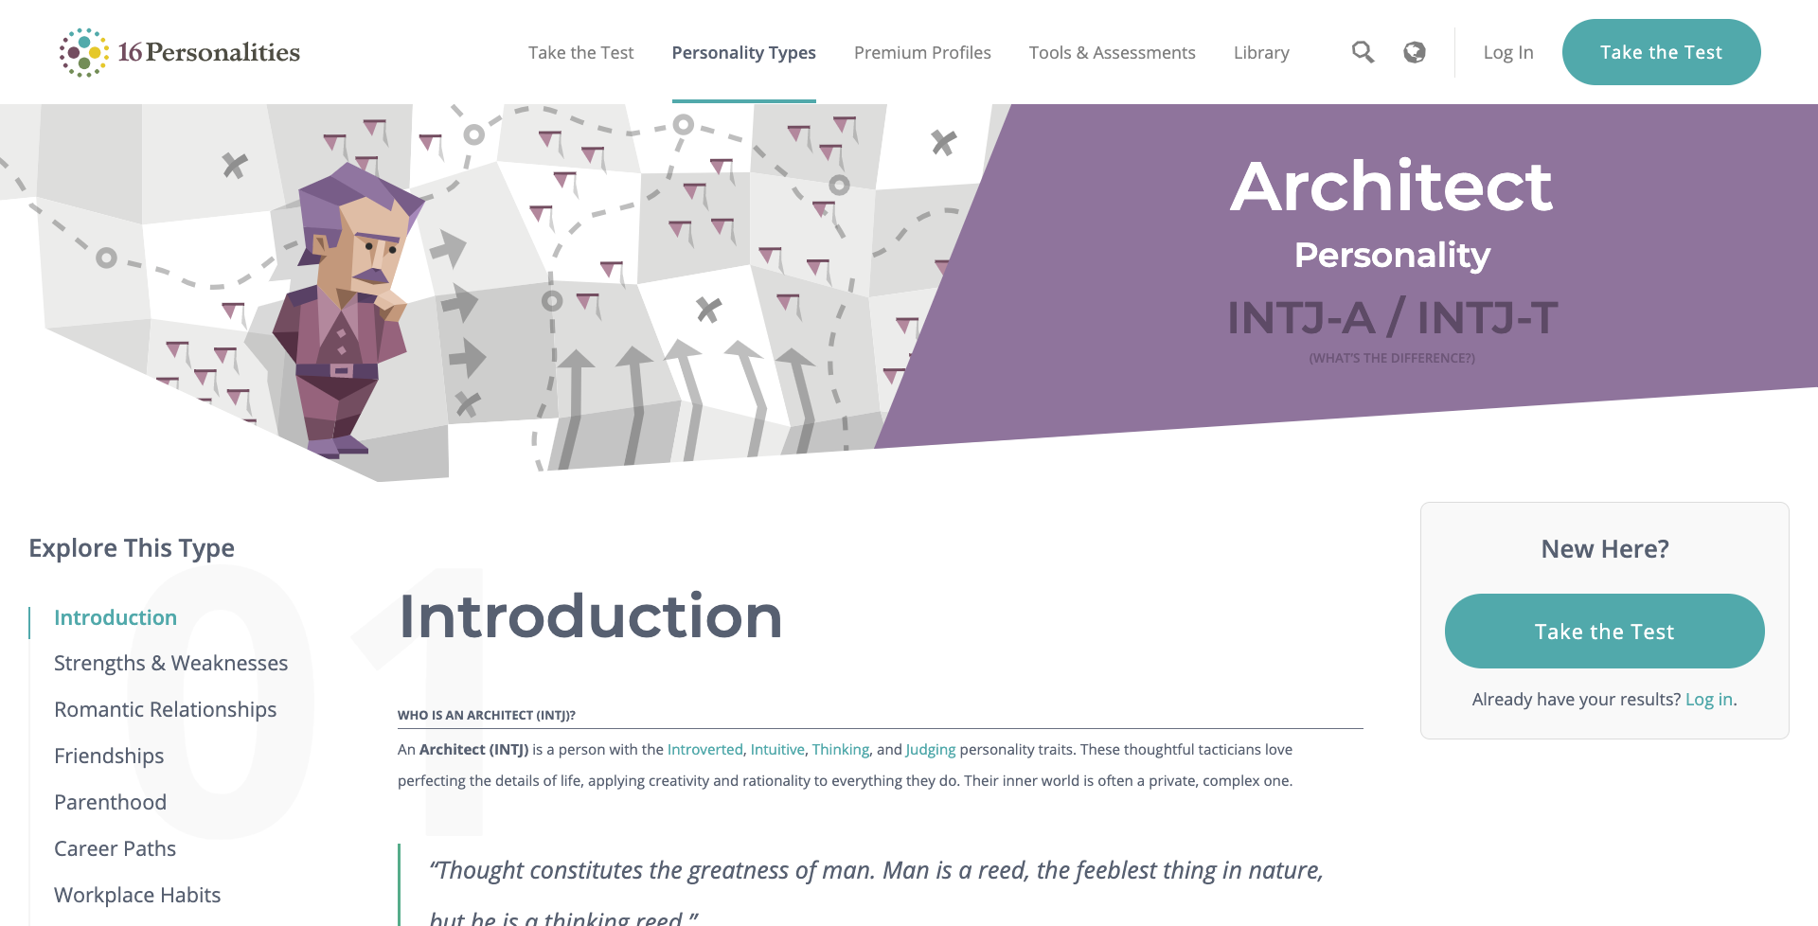
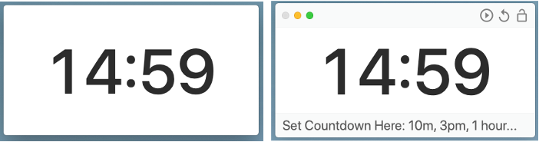
Do
Do

Slide 44
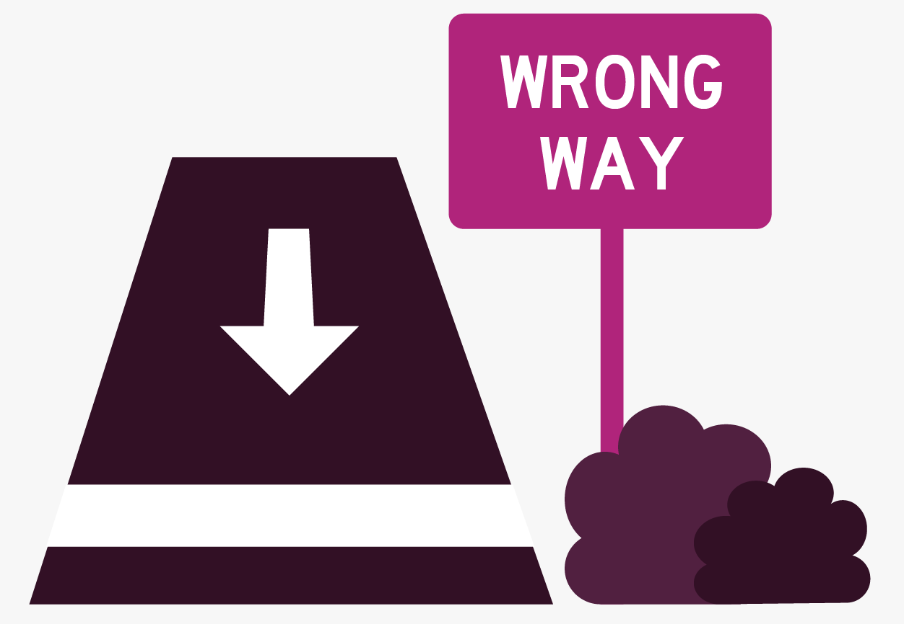
Help Users Recognize, Diagnose, and Recover from Errors
Error messages should be expressed in plain language (no error codes), precisely indicate the problem, and constructively suggest a solution.
These error messages should also be presented with visual treatments that will help users notice and recognize them.
Tips
Use traditional error-message visuals, like bold, red text.
Tell users what went wrong in language they will
understand — avoid technical jargon.
Offer users a solution, like a shortcut that can solve
the error immediately.

Slide 45
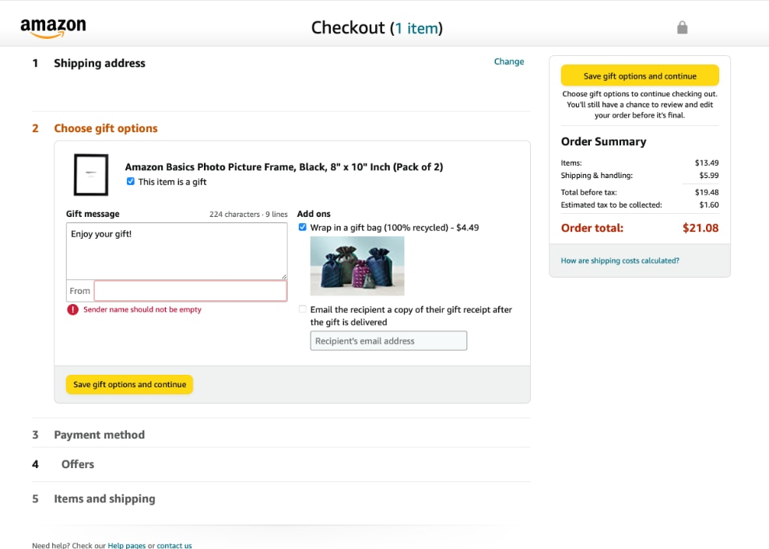
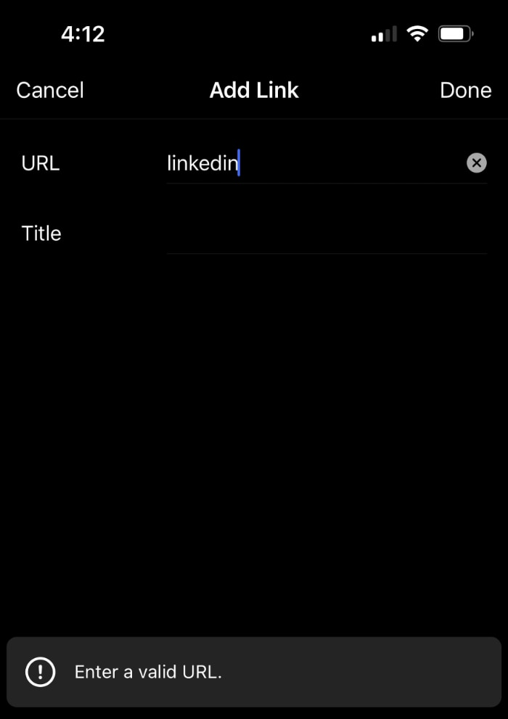
Do
Do

Slide 46
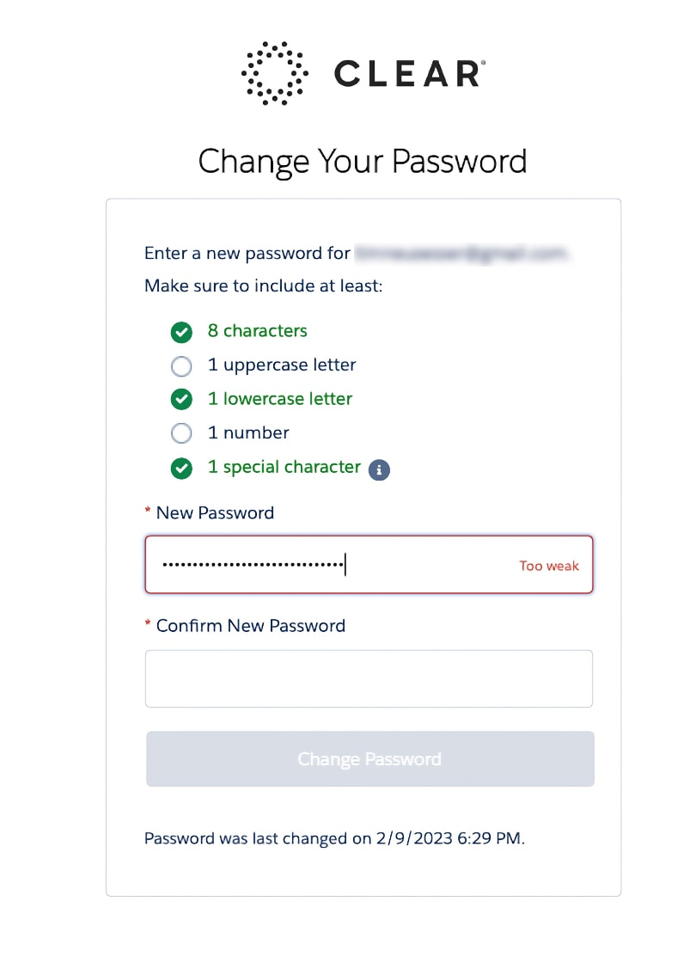
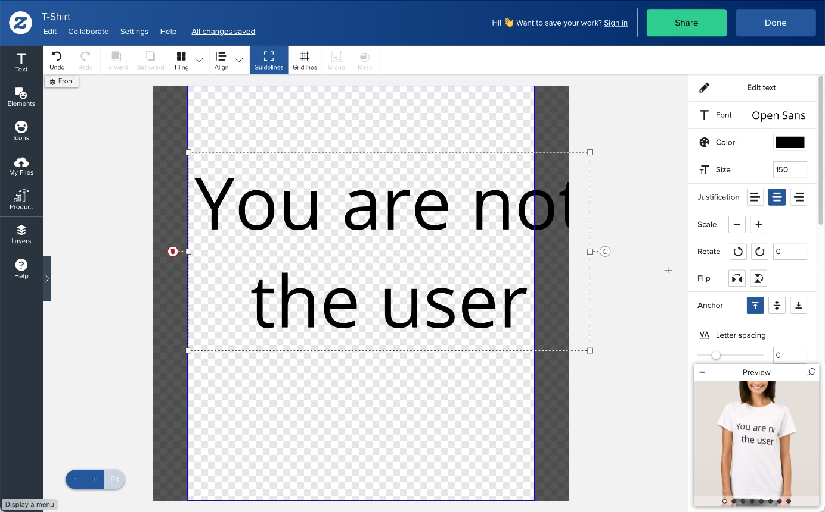
Do
Don’t

Slide 47
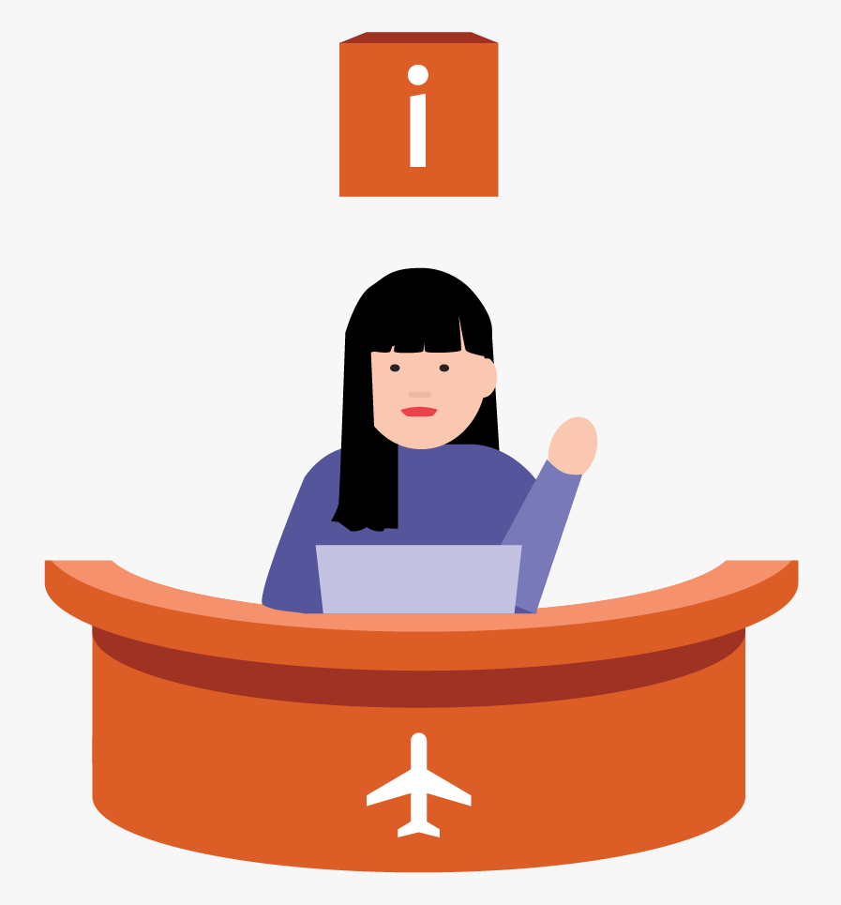
Help and Documentation
It’s best if the system doesn’t need any additional explanation.
However, it may be necessary to provide documentation to help users understand how to complete their tasks.
Help and documentation content should be easy to search and focused on the user's task.
Keep it concise, and list concrete steps that need to be carried out.
Tips
Ensure that the help documentation is easy to search.
Whenever possible, present the documentation in
context right at the moment that the user requires it.
List concrete steps to be carried out.

Slide 48
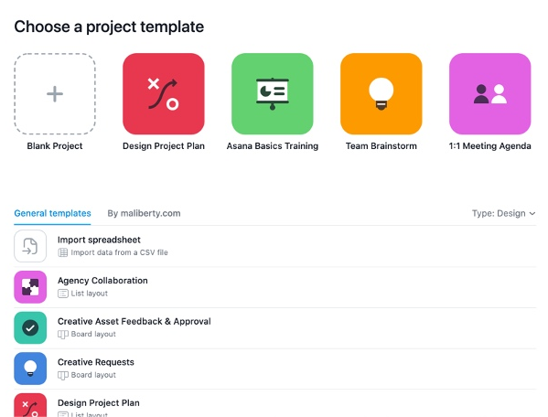
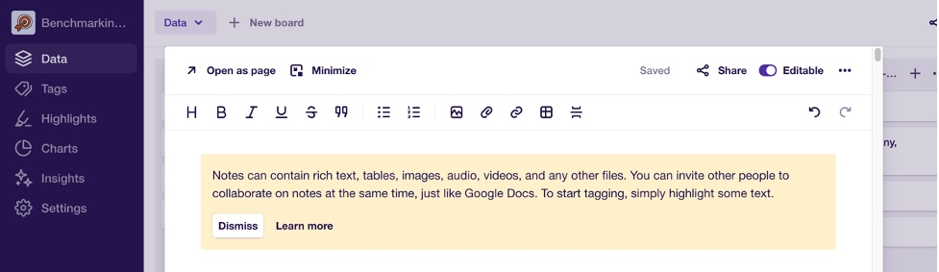
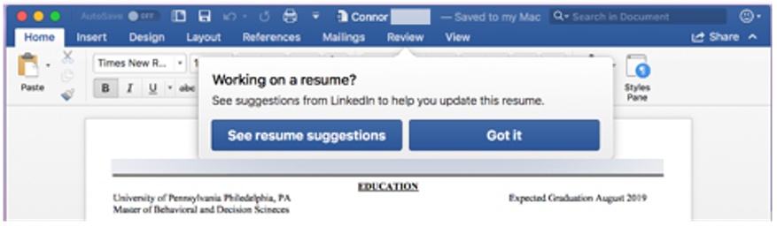
Do
Do

Slide 49
Observation
Section 4

Slide 50
#Define
Observation is a research method in UX design that involves observing and documenting how users interact with a product, system, or service.

Slide 51
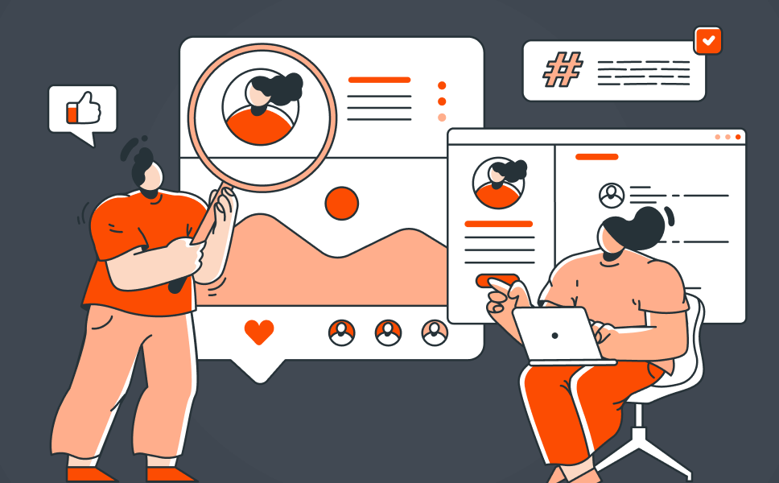
Observation (contd.)
Controlled observation tends to take place in a laboratory environment.
To carry out a controlled observation.
It’s best to formulate a series of observations and have the observer carry these out at each step in the process.
They can then record their observation quantitatively (e.g. yes/no or a rating scale out of 3 or 5) against each step.
Controlled observations require that the researcher explain the purpose of the observation to the user and that the participants know they are being observed.

Slide 52
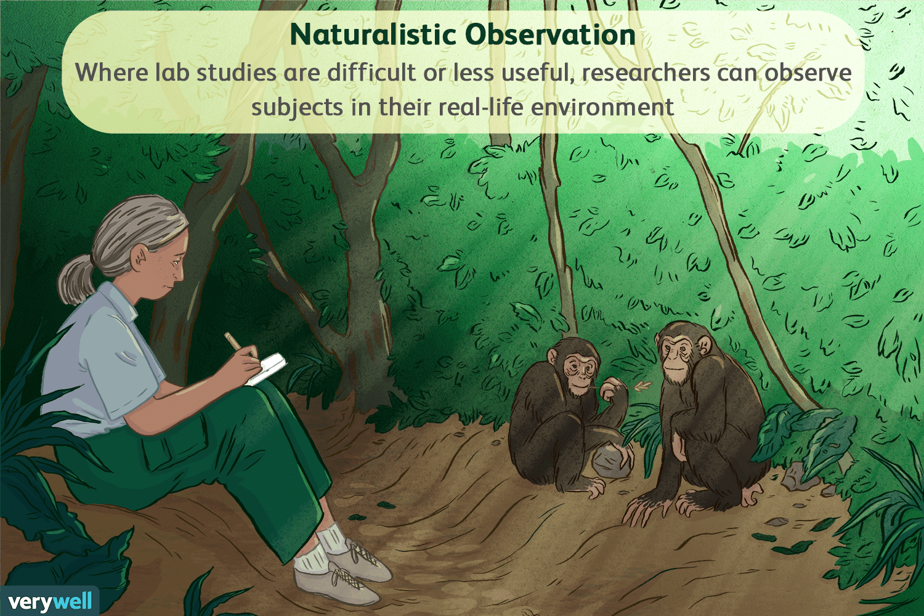
Observation (contd.)
A naturalistic observation involves studying the user “in the wild” and tends to be less structured.
Spend time with a user or group of users and observing their behavior with the product as they use it in day-to-day life.
The observer records their observations as they see fit.

Slide 53
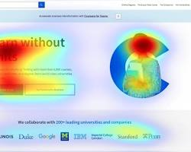
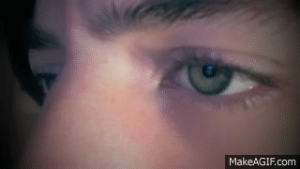
Observation – Eye tracking
Eye tracking technology measures eye movements and gaze, revealing where and how users visually interact with their environment.
Key Metrics:
Fixations: Points where the eye pauses.
Saccades: Rapid eye movements between fixations.
Pupil Dilation: Changes in pupil size, indicating cognitive load or emotional excitement.

Slide 54
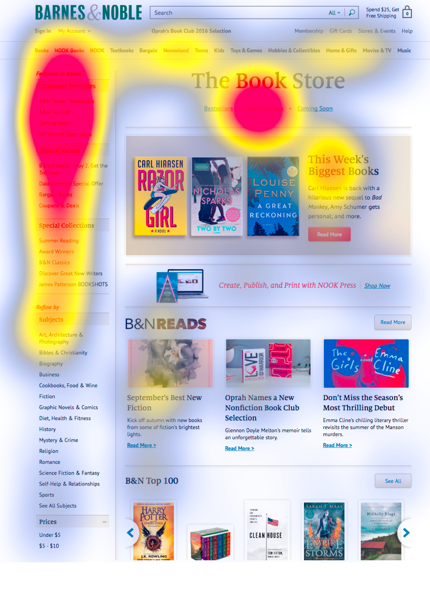
Eye Tracking - Benefits in UX Research
Understand User Attention:
Identify areas of interest and disinterest.
Optimize layout and design for visual hierarchy.
Improve Usability:
Detect usability issues and pain points.
Enhance user flow and navigation.
Measure User Engagement:
Assess how effectively content captures attention.
Optimize content placement and design for maximum impact.

Slide 55
Steps to Conduct Eye Tracking
Select Diverse Participants
Use realistic goals and scenarios
Limit Test Participants
Ensure transparency in reporting
Prepare Equipment
Engage in post-test dialogue
Create comfortable testing environment
Take detailed notes
Use off-screen prompts
Encourage real data inputs

Slide 56
Clickstream Analysis
Clickstream analysis is an observation technique to track the sequence and patterns of user clicks while interacting with an interface.
Benefits:
Reveals user journey and drop-off points.
Identifies popular features and underutilized elements.
Enhances website performance.
Google Analytics helps you capture:
Pages visited
Time spent
Click patterns
Applications of Clickstream Analysis
Mapping user journeys
Identifying user behavior trends
Improving conversion rates through insights

Slide 57
Focus Group
A focus group is used in usability and user research to collect the opinions of a group of users.
It consists of a carefully selected group of participants (between 5 and 10),
in a comfortable environment with a skilled moderator (facilitator)
who uses a script to ask questions of the group,
the answers are recorded and
then analyzed and reported to enable further decision making.
Benefits
Participants with similar goals or perspectives can build on each other’s responses or recall experiences in greater detail.
They can help teams clarify users’ mental models.
They can yield rich qualitative insights.

Slide 58
Key things to consider when planning your focus group
Recruit participants that are representative of your target audiences.
Note potential sources of bias from the focus group’s structure.
Treat your focus group like a workshop. Make participants comfortable with participating, verbally or nonverbally.

Slide 59
User Group
User group in UX research refers to a defined segment of people who share similar characteristics, behaviors, needs, and goals relevant to the product or service being designed.
These groups are used to ensure that the research focuses on the right audience to create meaningful and user-centered designs.
Key Characteristics:
Demographics: Age, gender, location, occupation, etc.
Psychographics: Interests, values, attitudes, and lifestyles.
Behavioral Traits: Usage patterns, device preferences, and interaction habits.
Needs and Goals: Specific problems they want to solve or objectives they wish to achieve.
Importance of Defining User Groups:
Focused Research: Ensures the study targets relevant users.
Improved Design: Helps create experiences tailored to the group's specific needs.
Efficiency: Saves time and resources by narrowing the scope of research.
Stakeholder Communication: Clearly communicates who the product is for and why certain design decisions are made.

Slide 60
User Group (Example)
For a food delivery app, user groups could include:
Busy Professionals: Need quick and reliable food options.
Students: Looking for affordable and diverse meal choices.
Health-Conscious Users: Prefer apps with detailed nutritional information.

Slide 61
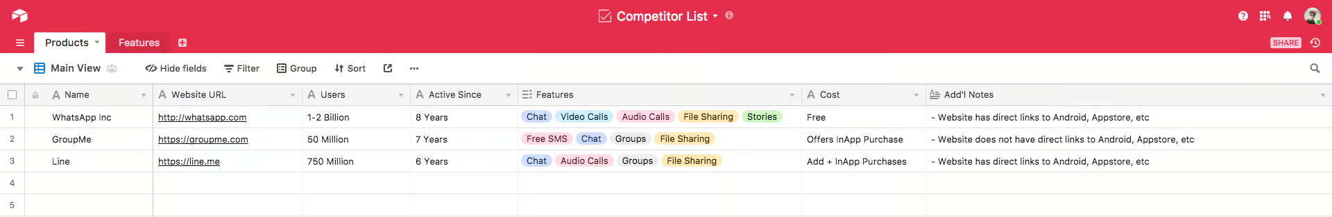
Competitive Audits
A competitive audit is an overview of your competitors' strengths and weaknesses.
A competitive audit is just one tool to explore ideas for designs, so we can learn from others about what has worked and not worked.
It helps you;
Identify your key competitors
Reviewing the product that your competitors offer
Understanding how your competitors position themselves in the market
Examining what your competition does well and what they could do better
Considering how your competitors talk about themselves
Types of competitors
Direct competitors
Indirect competitors

Slide 62
#Define
Direct Competitors are the who have offerings that are similar to your product and focus on the same audience.

Slide 63
#Define
Indirect competitors are the one who have a similar set of offerings but focus on a different audience, or have a different set of offerings and focus on the same audience.

Slide 64
Benefits of Competitive Analysis
Benefit | Description
Inform your design process | How did your competitors approach designing their products? Knowing what others have done can help you make better design decisions for your own product.
Solve usability problems | Is your competitors website difficult to use? If so, you know what to avoid for your own website.
Reveal gaps in the market | Are there user needs your competitors do not meet? Your product might be able to address these user needs.
Provide reliable evidence | Why is it important to gather evidence? Design ideas are most successful when there's a deep understanding of business needs and market gaps.

Slide 65
Limitations of Competitive Analysis
Limitation | Description
Stifle Creativity | If you spend too much time focusing on what others are doing, you might prevent yourself from creating a truly innovative product. Innovation doesn't happen by copying the competition. The key is to understand what the competition is doing and use that as a starting point to push forward and innovate.
Need to be done regularly | You want to stay on top of what your competitors are doing and keep an eye out for new competitors that might emerge.

Slide 66
Limitations of Competitive Analysis (contd.)
Limitation | Description
Not all designs work in all use cases | The features that work well for a competitor might not work well for your product, if you serve different users. E.g., imagine you're designing a website for a clothing company. A competitor has a feature that shows photos of customers wearing their brand's clothing on social media. But if your audience doesn't regularly use social media, this feature is not a good fit for your clothing website.
Need to be done regularly | You want to stay on top of what your competitors are doing and keep an eye out for new competitors that might emerge.

Slide 67
Thank you

